Slide 1
Factorial Analysis of factors impacting tomato germination and growth
By: Macie Hanneken

Slide 2
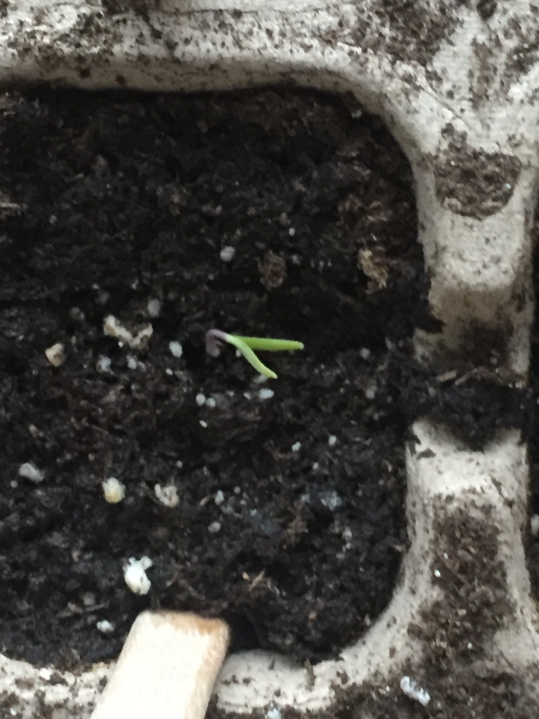
Introduction
Wanted to determine what factors had an impact on tomato growth
for future gardening use
4 week long experiment
Days to Germination: days until the seed sprouts
Seedling height after completion of experiment
Factors used in analysis
Days between watering
0, 1, or 2 days
Soil Type
Tomato feed or no tomato feed
Notes:
Look up ingredients in soil used for each type and the tomato feed

Slide 3
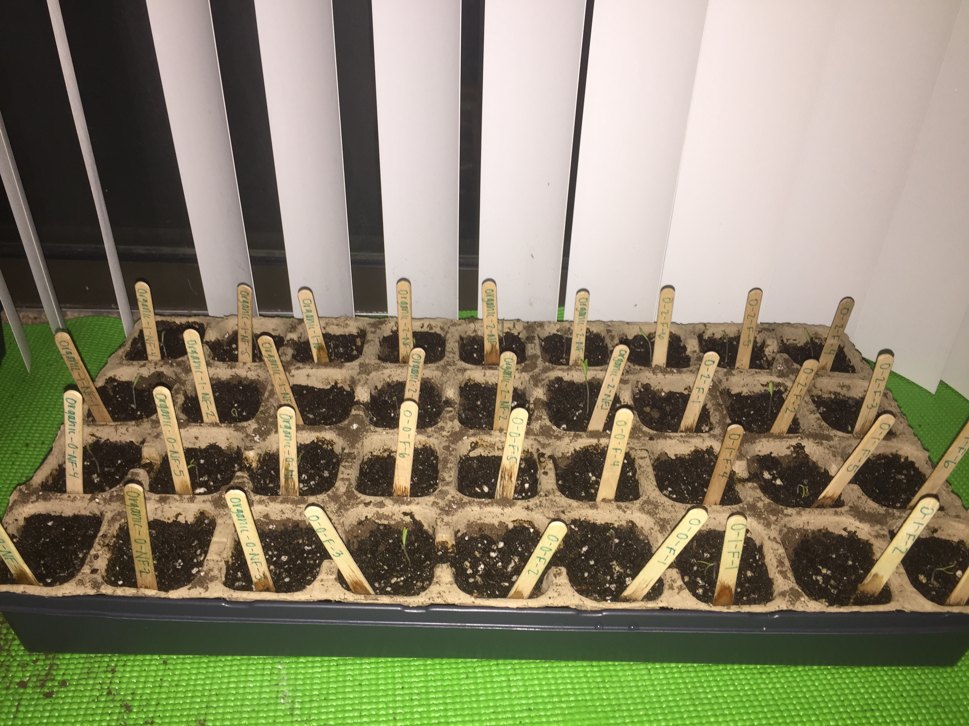
Experimental design
Planted one seed per square in two 36 square planters.
One of the 36 square planters had the organic soil, and the other had the non-organic soil
Each of the planter’s squares was then sectioned off to have tomato feed or no tomato feed and different number of days between waterings.
There were six replicates for each of the different factor combinations, making a total of 72 individual plants
The location of the different factors were chosen by random selection using a random number generator with the different factors and replicates used as a different number.

Slide 4
Methods
After the plants were planted, they were watered with 3 tablespoons of water initially to ensure the soil was not dry.
For the duration of the experiment each of the plants were watered with 2 tablespoons of water on their designated days of watering (Recall every 0, 1, or 2 days)
Plants that were given tomato feed were watered with 1 tablespoon of feed per gallon of water per suggestion for seeds and seedlings on the tomato feed and only watered with that water once a week as recommended by the tomato feed brand.
Plant beds were check every day and watered every day at approximately 6pm
Germination dates were recorded at this time
Seedling growth was measured in centimeters at the end of the experiment

Slide 5
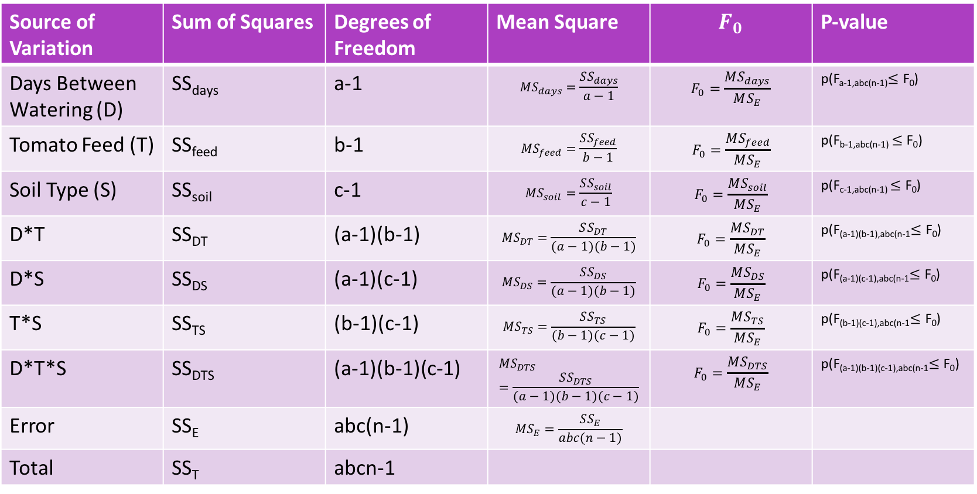
Data analysis
Source of Variation | Sum of Squares | Degrees of Freedom | Mean Square | $$F_{0}$$ | P-value
Days Between Watering (D) | SS_{days} | a-1 | $$MS_{days}=\frac{SS_{days}}{a−1}$$ | $$F_{0}=\frac{MS_{days}}{MS_{E}}$$ | p(F_{a-1,abc(n-1)}$≤\text{F}\text{0}$)
Tomato Feed (T) | SS_{feed} | b-1 | $$MS_{feed}=\frac{SS_{feed}}{b−1}$$ | $$F_{0}=\frac{MS_{feed}}{MS_{E}}$$ | p(F_{b-1,abc(n-1)} $≤\text{F}\text{0}$)
Soil Type (S) | SS_{soil} | c-1 | $$MS_{soil}=\frac{SS_{soil}}{c−1}$$ | $$F_{0}=\frac{MS_{soil}}{MS_{E}}$$ | p(F_{c-1,abc(n-1)} $≤\text{F}\text{0}$)
D*T | SS_{DT} | (a-1)(b-1) | $$MS_{DT}=\frac{SS_{DT}}{(a−1)(b−1)}$$ | $$F_{0}=\frac{MS_{DT}}{MS_{E}}$$ | p(F_{(a-1)(b-1),abc(n-1}$≤\text{F}\text{0}$)
D*S | SS_{DS} | (a-1)(c-1) | $$MS_{DS}=\frac{SS_{DS}}{(a−1)(b−1)}$$ | $$F_{0}=\frac{MS_{DS}}{MS_{E}}$$ | p(F_{(a-1)(c-1),abc(n-1}$≤\text{F}\text{0}$)
T*S | SS_{TS} | (b-1)(c-1) | $$MS_{TS}=\frac{SS_{TS}}{(b−1)(c−1)}$$ | $$F_{0}=\frac{MS_{TS}}{MS_{E}}$$ | p(F_{(b-1)(c-1),abc(n-1}$≤\text{F}\text{0}$)
D*T*S | SS_{DTS} | (a-1)(b-1)(c-1) | $$MS_{DTS}=\frac{SS_{DTS}}{(a−1)(b−1)(c−1)}$$ | $$F_{0}=\frac{MS_{DTS}}{MS_{E}}$$ | p(F_{(a-1)(b-1)(c-1),abc(n-1}$≤\text{F}\text{0}$)
Error | SS_{E} | abc(n-1) | $$MS_{E}=\frac{SS_{E}}{abc(n−1)}$$
Total | SS_{T} | abcn-1
Notes:
Reject if p-value is larger

Slide 6

Data analysis
The Model: $Y_{ijkl}=τ_{i}+β_{j}+γ_{k}+{\left(τβ\right)}_{ij}+{\left(τγ\right)}_{ik}+{\left(βγ\right)}_{jk}+{\left(τβγ\right)}_{ijk}+ε_{ijkl}$
$τ_{i}$ is the fixed effects of the different types of soil
$β_{j}$ is the fixed effects of the different days between waterings
$γ_{k}$ is the fixed effects of the absence or presence of tomato feed

Slide 7


Data analysis
The hypotheses:
$\left\{\begin{aligned}τ_{1}=τ_{2}=0 \\ at least one τ_{i}≠0\end{aligned}\right.$
$\left\{\begin{aligned}β_{1}=β_{2}=β_{3}=0 \\ at least one β_{j}≠0\end{aligned}\right.$
$\left\{\begin{aligned}γ_{1}=γ_{2}=0 \\ at least one γ_{k}≠0\end{aligned}\right.$
$$\left\{\begin{aligned}{(τβ)}_{ij}=0 \\ at least one {(τβ)}_{ij}≠0\end{aligned}\right.$$
$$\left\{\begin{aligned}{(τγ)}_{ik}=0 \\ at least one {(τγ)}_{ik}≠0\end{aligned}\right.$$
$$\left\{\begin{aligned}{(βγ)}_{jk}=0 \\ at least one {(βγ)}_{kj}≠0\end{aligned}\right.$$

Slide 8
Data analysis
Conducted a factorial analysis on the three different factors (days between waterings, absence or presence of tomato feed, and soil type) and their interaction on their effect on the days until germination and the height of the individual plants at the end of the experiment.
This was done in two separate factorial analyses
First things first, model adequacy checking!
Are our residuals normal?
Do we have constant variance?
Next, factorial analysis of variance!
Do our interactions have a significant impact?
If so, we will look at a reduced model with just those factors
If not, we will just carry on
Notes:
For normalcy, we will take a look at the QQ plot, for constant variance, we will look at the residuals vs. the predicted values and see if its nice and evenly spred

Slide 9
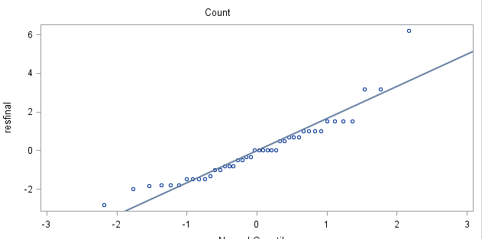
Data analysis: days to germination
Based on p-value of Shapiro Wilks test <.05 and the qq-plot, we can see that the residuals for this analysis is not normally distributed, and therefore cannot continue with the analysis without a transformation
Tests for Normality
Test | Statistic |  | p Value
Shapiro-Wilk | W | 0.907206 | Pr < W | 0.0024

Slide 10
Data analysis: Days to germination
The plot of the predicted values vs. the residuals of the untransformed data.
From this we can see that constant variacne was not met either.
Therefore we must do a transformation!
Plot of resfinal*prefinal. Legend: A = 1 obs, B = 2 obs, etc. resfinal | | 7 + | | | | A 6 + | | | | 5 + | | | | 4 + | | | | B 3 + | | | | 2 + | | D | | 1 + D | | B C | | 0 + A C A A | | B B | | C -1 + B | | D A | | D -2 + A | | | | A -3 + | ---+----------+----------+----------+----------+----------+----------+----------+----------+----------+----------+-- 9 10 11 12 13 14 15 16 17 18 19 prefinal NOTE: 30 obs had missing values.

Slide 11
Data analysis: Days to germination
Transformation of Data to meet normalcy and constant variance assumptions
Only transformed the y-value, so the days to germination
Tried: square root, squared, log10, log2, and natural log transformations
The natural log gave the highest p-value for the Shapiro-Wilks test for normality of the residuals and most spread out plot of the predicted vs. the residual values.
So this is the transformation I went with!
Now on to the factorial ANOVA!

Slide 12
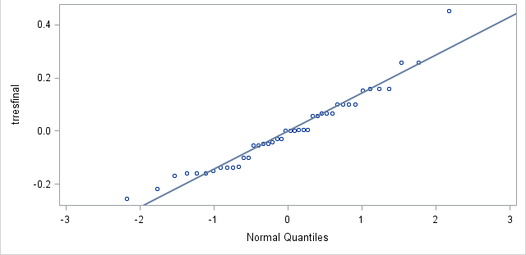
Data analysis: Days to germination
P-value for Shapiro-Wilks test > .05, and the qq-plot looks much better. Therefore assumption for normality is met.
Tests for Normality
Test | Statistic |  | p Value
Shapiro-Wilk | W | 0.956874 | Pr < W | 0.1141

Slide 13
Data analysis: Days to germination
Plot of trresfinal*trprefinal. Legend: A = 1 obs, B = 2 obs, etc.
trresfinal |
|
0.5 +
|
|
| A
|
|
|
0.4 +
|
|
|
|
|
|
0.3 +
|
|
| B
|
|
|
0.2 +
|
|
| CA
|
|
|
0.1 + D
|
| C
| B
|
|
|
0.0 + A C A A
|
| B
| B A
| B
|
|
-0.1 + B
|
| A
| C A
| C
| A
|
-0.2 +
| A
|
|
| A
|
|
-0.3 +
|
--+-------------+-------------+-------------+-------------+-------------+-------------+-------------+-------------+-
2.2 2.3 2.4 2.5 2.6 2.7 2.8 2.9 3.0
trprefinal
Looks a bit better than the untransformed data, so we accept the assumption of constant variance and carry on with the analysis.

Slide 14
Data analysis: Days to germination
Source | DF | Type I SS | Mean Square | F Value | Pr > F
Soil | 1 | 0.05057799 | 0.05057799 | 1.87 | 0.1818
Days | 2 | 0.12869643 | 0.06434821 | 2.37 | 0.1099
Soil*Days | 2 | 0.09654011 | 0.04827005 | 1.78 | 0.1854
Feed | 1 | 0.00149074 | 0.00149074 | 0.05 | 0.8162
Soil*Feed | 1 | 0.36824000 | 0.36824000 | 13.58 | 0.0009
Days*Feed | 2 | 0.01164411 | 0.00582206 | 0.21 | 0.8080
Soil*Days*Feed | 1 | 0.07340480 | 0.07340480 | 2.71 | 0.1100
Error | 31 | 0.84053326 | 0.02711398
Corrected Total | 41 | 1.57112743
Notes:
Only thing that’s significant at the .05 level is the soil*feed treatment interaction. Since that was significant, I decided to do a quick look at the reduced model to see if either of the individual factors had an effect on the days to germination

Slide 15
Data analysis: Days to germination (Reduced model)
Source | DF | Type I SS | Mean Square | F Value | Pr > F
Soil | 1 | 0.05057799 | 0.05057799 | 1.30 | 0.2609
Feed | 1 | 0.00490959 | 0.00490959 | 0.13 | 0.7242
Error | 39 | 1.51563985 | 0.03886256
Corrected Total | 41 | 1.57112743
Notes:
Nothing significant!!

Slide 16
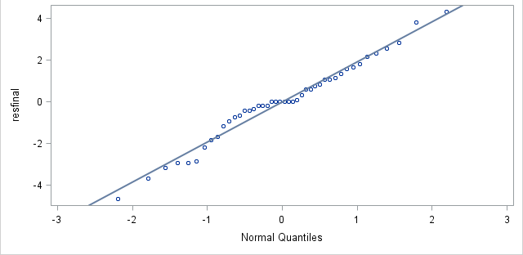
Data analysis: seedling height
P-value for Shapiro-Wilks test > .05, and the qq-plot looks pretty good. Therefore assumption for normality is met.
Tests for Normality
Test | Statistic |  | p Value
Shapiro-Wilk | W | 0.979675 | Pr < W | 0.6207
Notes:
Both the model and the hypotheses are the same as they were in the first analyses, the only difference is that we are now looking at the effects of these variables on seedling height instead of days to germination. Can see, unlike last model, error term is normally distributed with no need for transformation!

Slide 17
Data analysis: seedling height
Plot of resfinal*prefinal. Legend: A = 1 obs, B = 2 obs, etc. resfinal | | 5 + | | | A | 4 + | A | | | 3 + | A | A | A | A 2 + | A | AA | A | A 1 + A A | A A | B | A | 0 + C A A A A | A A A | A B | A | A -1 + A | A | | A | A -2 + | A | | | A -3 + A A | A | | A | -4 + | | | A | -5 + | ---+---------+---------+---------+---------+---------+---------+---------+---------+---------+---------+---------+-- 3.5 4.0 4.5 5.0 5.5 6.0 6.5 7.0 7.5 8.0 8.5 9.0 prefinal NOTE: 28 obs had missing values.
Not too bad! Evenly spread and can assume that constant variance assumption has been met!
Notes:
Plot of predicted vs. residual values to determine if constant variance is met.

Slide 18
Data analysis: seedling height
Source | DF | Type I SS | Mean Square | F Value | Pr > F
Soil | 1 | 6.91414141 | 6.91414141 | 1.39 | 0.2474
Days | 2 | 12.62178363 | 6.31089181 | 1.27 | 0.2954
Soil*Days | 2 | 9.85043860 | 4.92521930 | 0.99 | 0.3831
Feed | 1 | 0.61602564 | 0.61602564 | 0.12 | 0.7274
Soil*Feed | 1 | 0.86250971 | 0.86250971 | 0.17 | 0.6801
Days*Feed | 2 | 13.32702020 | 6.66351010 | 1.34 | 0.2767
Soil*Days*Feed | 2 | 20.81944444 | 10.40972222 | 2.09 | 0.1402
Error | 32 | 159.3750000 | 4.9804687
Corrected Total | 43 | 224.3863636
Notes:
Nothing significant!!!

Slide 19
Results
The Feed*Soil interaction for the days to germination was the only thing that was significant for the data
There were no factors or their interactions that were significant to seedling height at the end of the experiment

Slide 20
Discussion
A lot of the plants in the non-organic soil didn’t sprout. Only 7 out of the 36 in the bed sprouted.
Increased time to germination due to soil composition or other factors due to soil
Soil less absorbent than non-organic, seeds may have been carried away by water.
Unlikely explanation: a lot of bad seeds
The point of having increased days between watering was to induce some form of water deprivation, but I think 2 tablespoons of water for each square was too much water, so they increased days between waterings had no effect.
Next time I would reduce the amount of water substantially in order to (hopefully) get more interesting results

Slide 21
Future things
The experiment was really short term.
Would have been interested to carry this out long term and see the effect on the size of the tomato and possible seed production.
The tomato seedlings were also kept in my apartment due to the cold weather when the experiment started. Would be interesting to conduct something like this in a greenhouse.
Would be interested in looking at the same effects but with a plant that is a harder to grow and keep alive

Slide 23
Questions?!

